Slide 1

What’s new with NativeScript! 🔥
2.3 is ready to rock!
Notes:
Tj First of all, I again want to thank everyone for coming out to the first ever NativeScript Developer Day.
Our notes: https://paper.dropbox.com/doc/Newest-and-Greatest-in-N-2.3-GFBEmbM2Maai9cGTjrAQB

Slide 2
🎉 TJ and Jen 🎈
@tjvantoll @jenlooper
Notes:
Jen … your hosts today

Slide 3
What’s new in….
Core 🚀
Tooling 🔧
Plugins 🔌
Community 💖
Apps 📱
Notes:
jen

Slide 4
Core 🚀
Notes:
TJ NativeScript 2.3 was released last week, and it, along with NativeScript 2.2 had a lot of really cool features.

Slide 5
Core 🚀
CLI updates 💣
Webpack 📦
Threading ⛓
Angular 😍
Notes:
tj

Slide 6
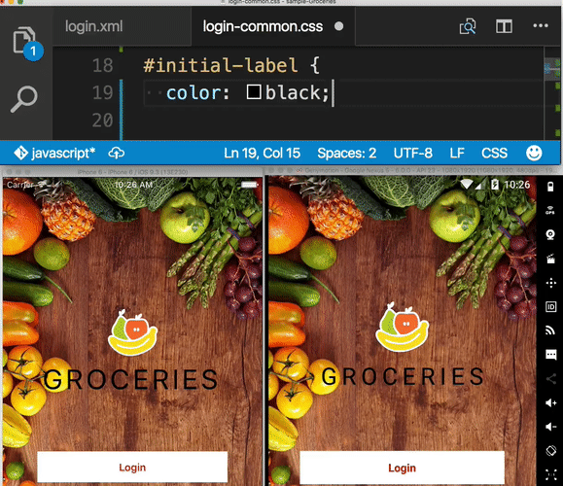
LiveSync on multiple devices 📱📱
Notes:
tj

Slide 7
Run and watch at the same time 🏃⌚
tns run ios --watch
tns run android --watch
Notes:
tj

Slide 8
LiveSync debugging support 🐛
LiveSync and debug
AT THE SAME TIME
tns debug ios|android --watch
Notes:
tj

Slide 9
Webpack 📱➡📦
tns install webpack
Notes:
tj

Slide 10
It makes a difference ⏱
tns build android --bundle
~35% reduction in app size
Notes:
Tj

Slide 11
Threading ⛓
NativeScript = single threaded, by default 🔗
Samples for background execution are now available.
WebWorkers API coming soon
Notes:
tj

Slide 12
Angular 😍
Angular 2 final—Now 100% more a thing 🎉
Notes:
tj

Slide 13
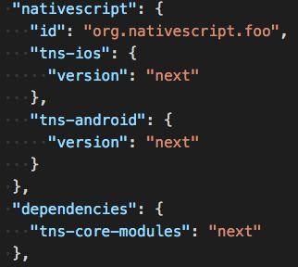
@next builds
npm install -g nativescript@next
Notes:
tj

Slide 14
Tooling 🔧
Notes:
jen

Slide 15
Tooling 🔧
Theme 🎨
Code Samples 💻
UI for NativeScript 📅📈📊
Telerik Platform 📱
Notes:
jen

Slide 16
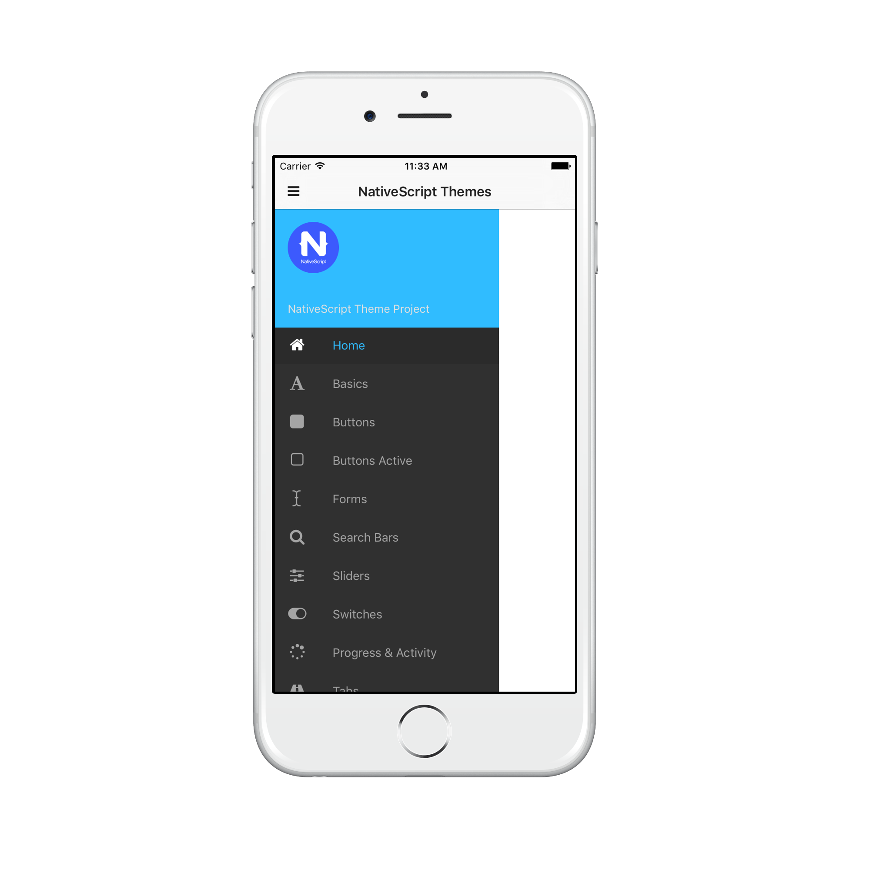
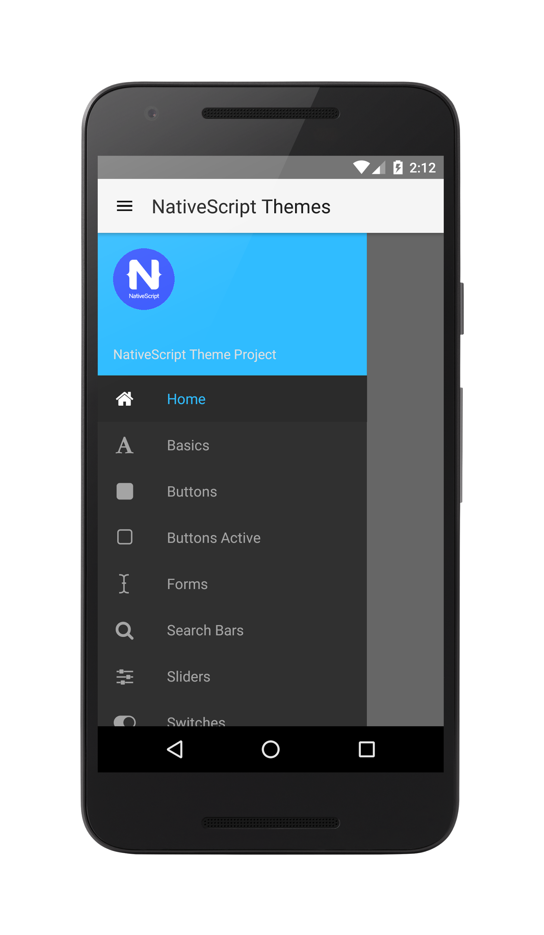
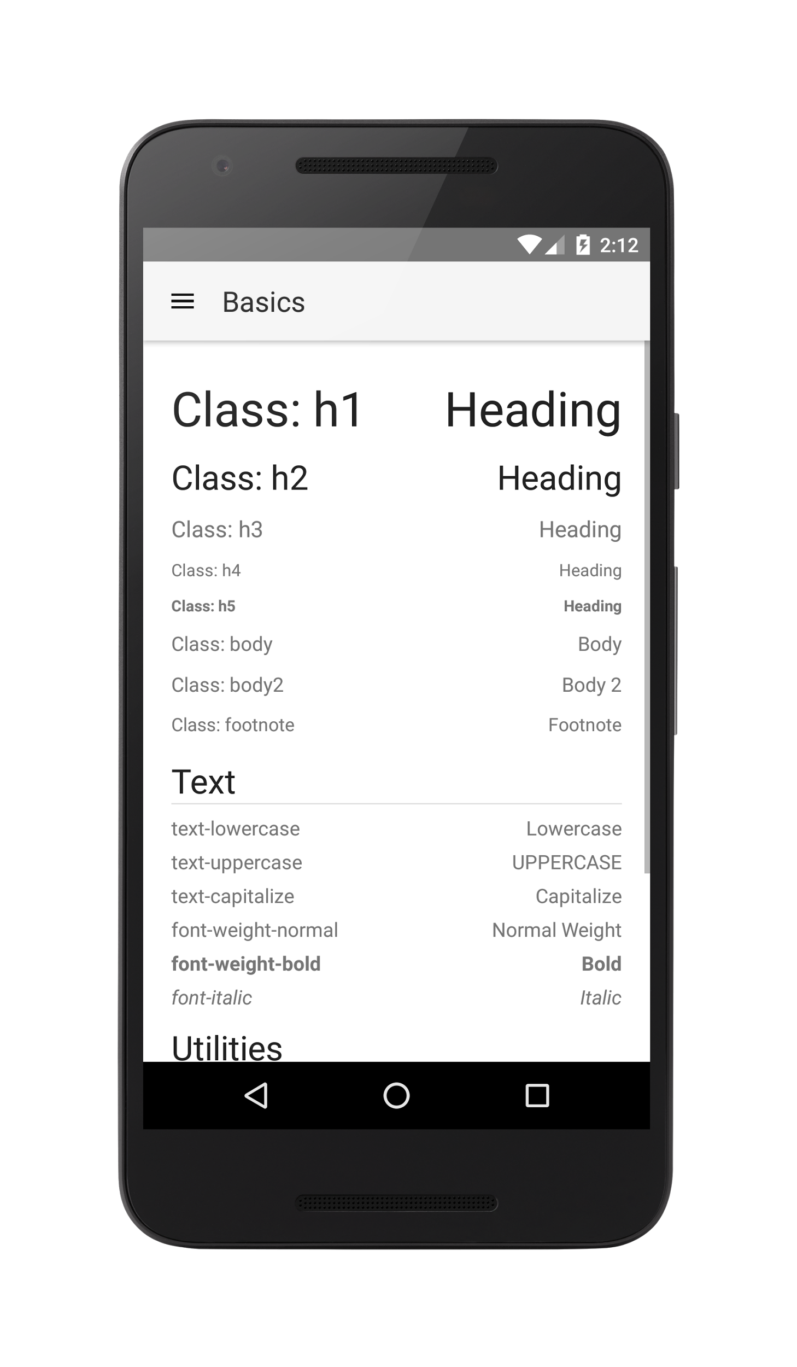
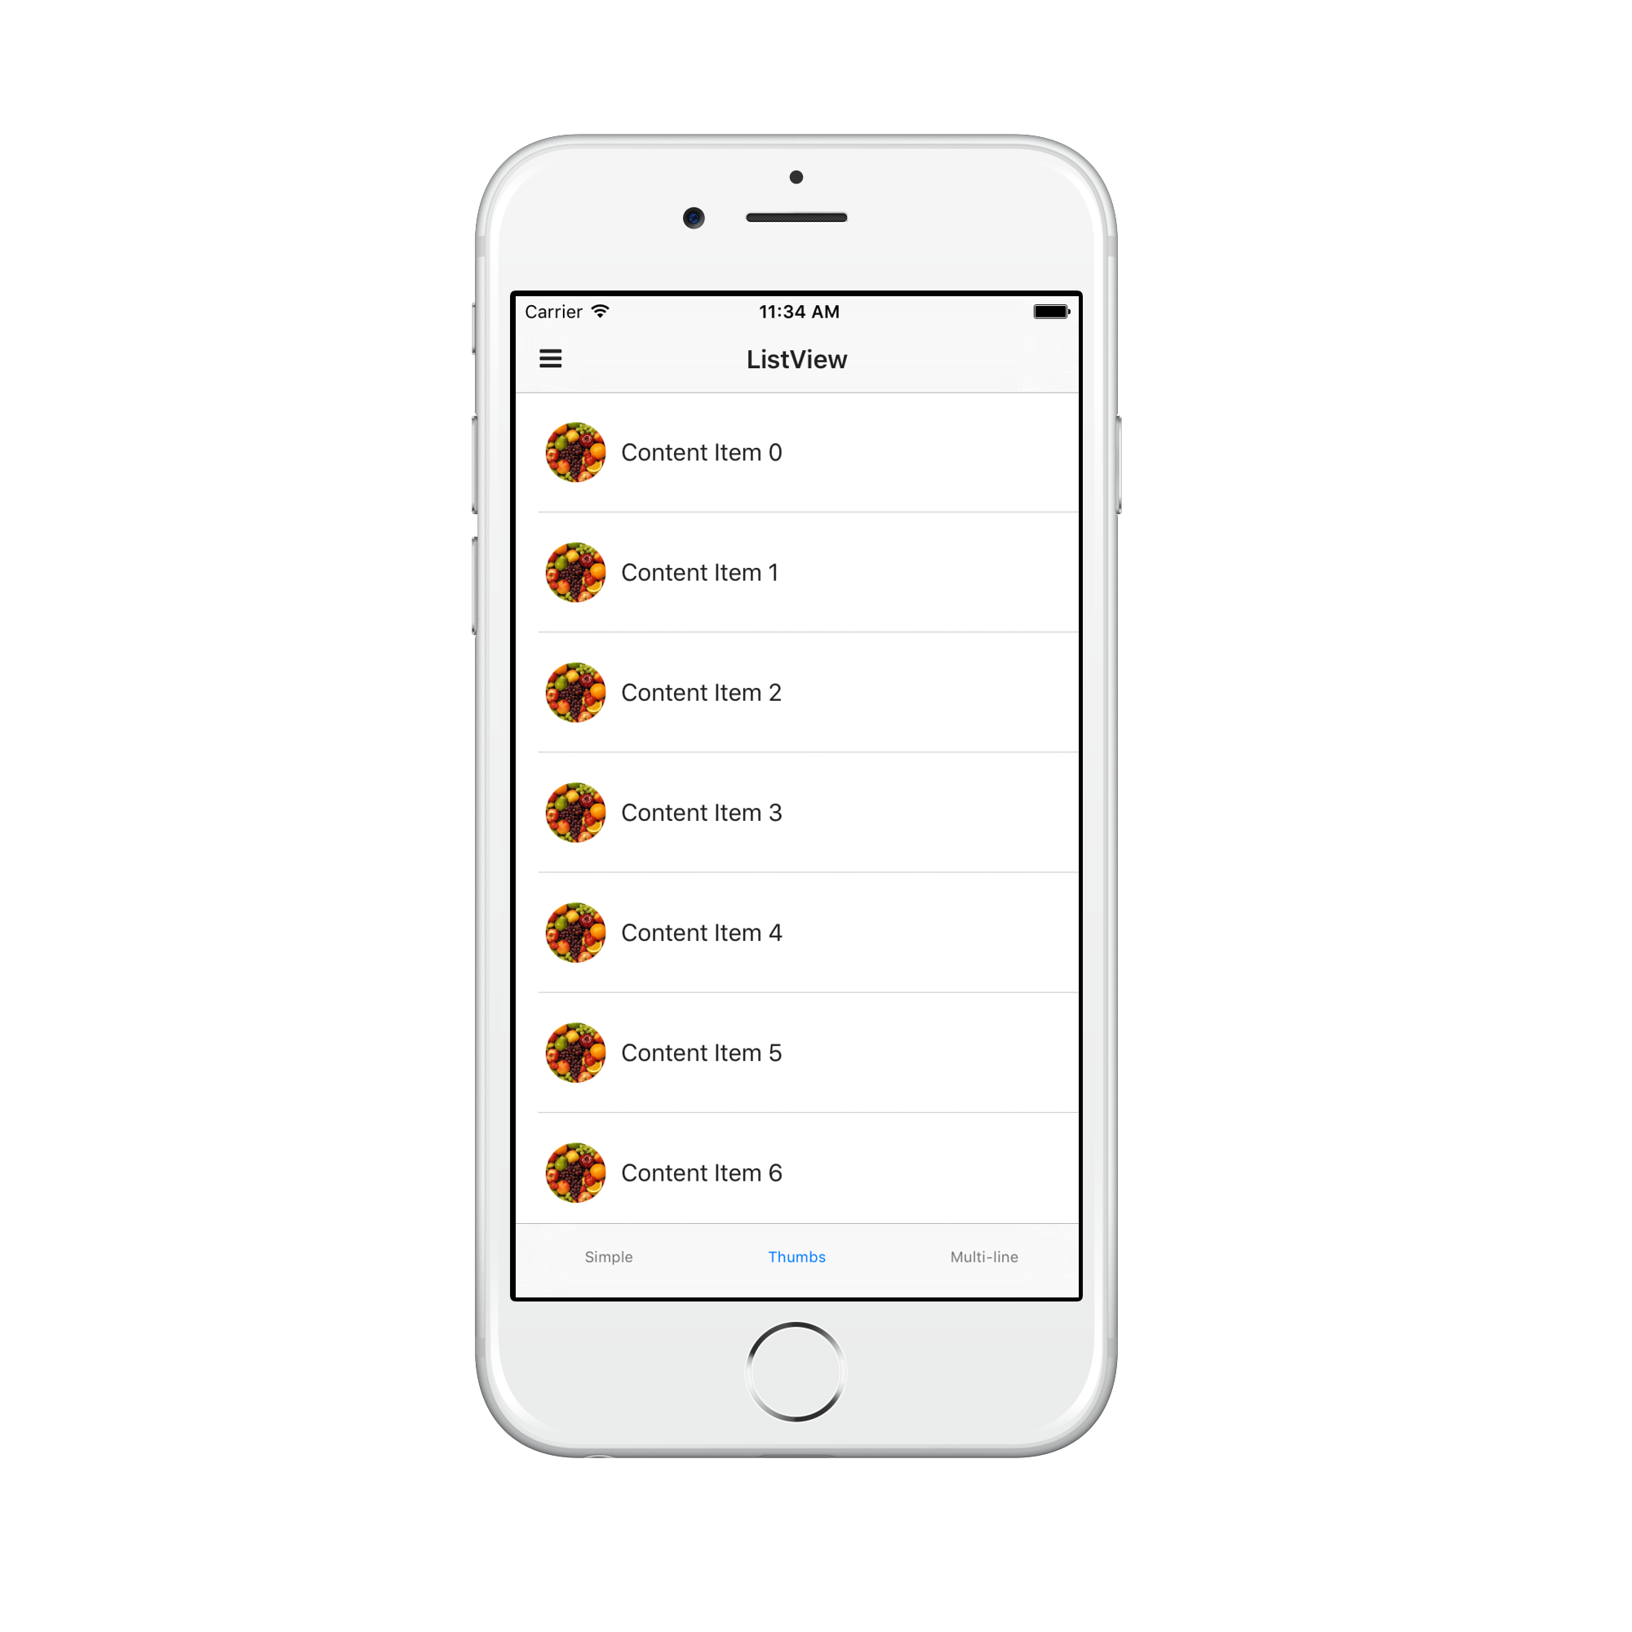
Theme 🎨
Notes:
Jen community effort to create beautiful skins that will ship in default apps soon. We are looking for feedback on these!

Slide 17
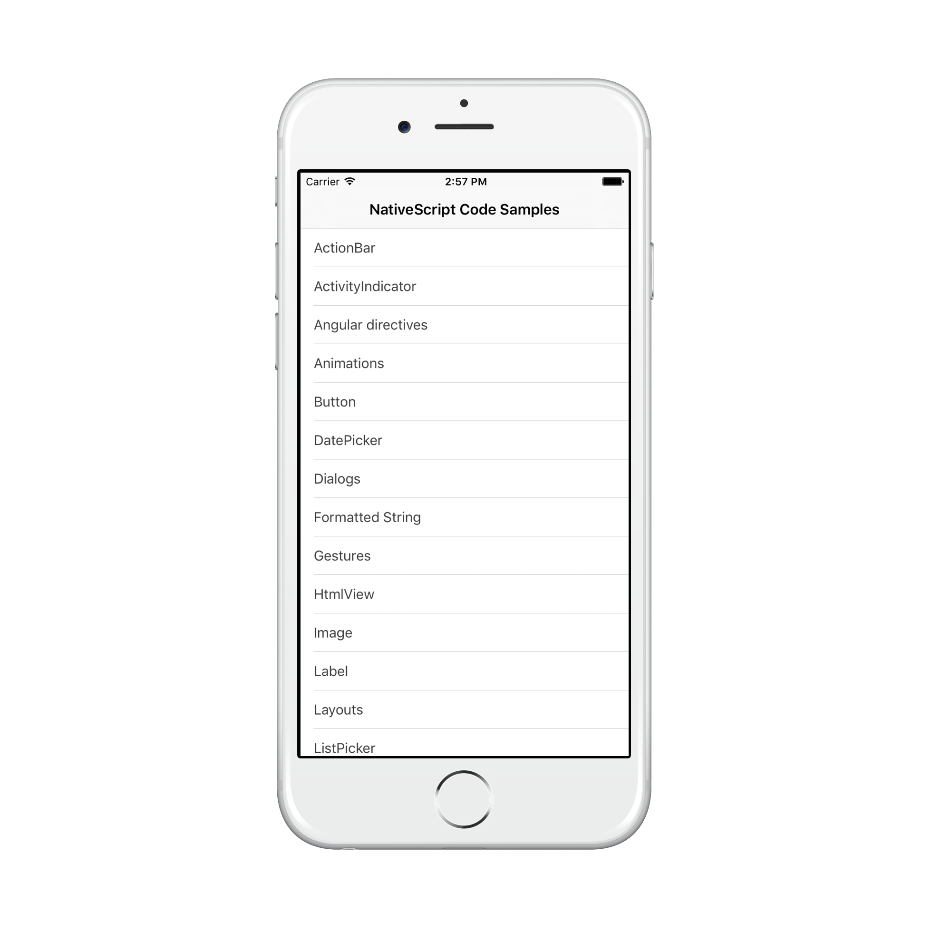
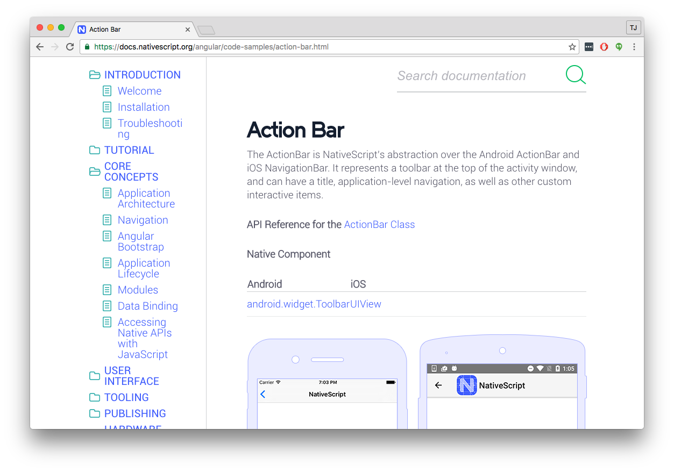
Code Samples 💻
Notes:
Jen you can go to docs and look for ‘code samples’ in the side bar. These are copy and paste-friendly samples of common UI scenarios- find these on github and build to your device to test them out.
Thee are all opensource to please take a look and consider contributing.

Slide 18
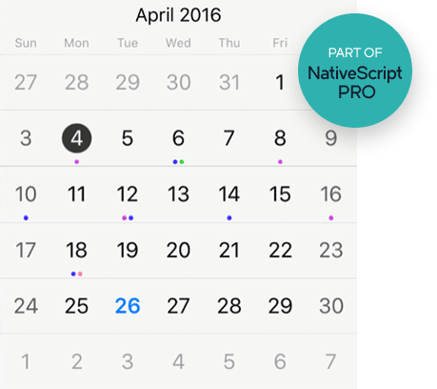
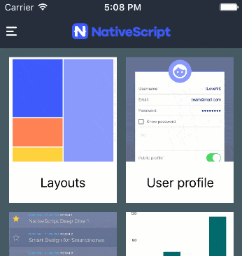
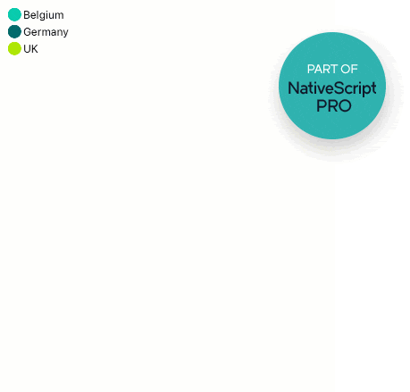

UI for NativeScript 📅📈📊
We already have...
Notes:
Jen build beautiful UI with UI for N - a library you can add to your app - these are premium ui components. You may already know our graphs, charts, sideview, and calendar.

Slide 19
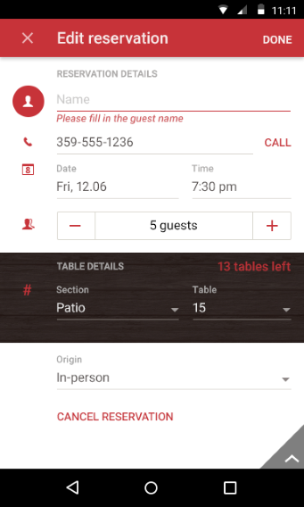
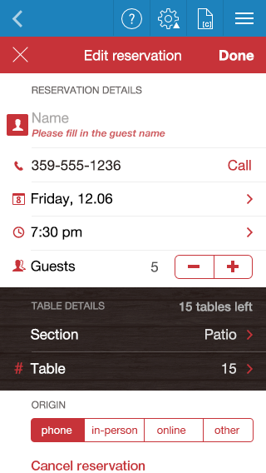
UI for NativeScript 📅📈📊
Dataform is new!
Notes:
Jen our newest addition to UI for N is the beautiful data form

Slide 20
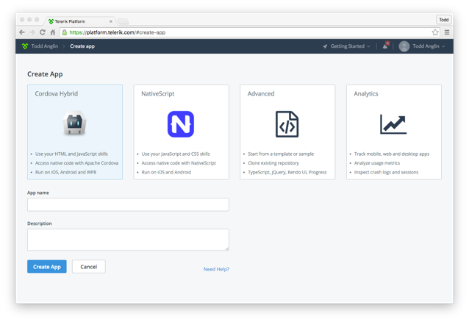
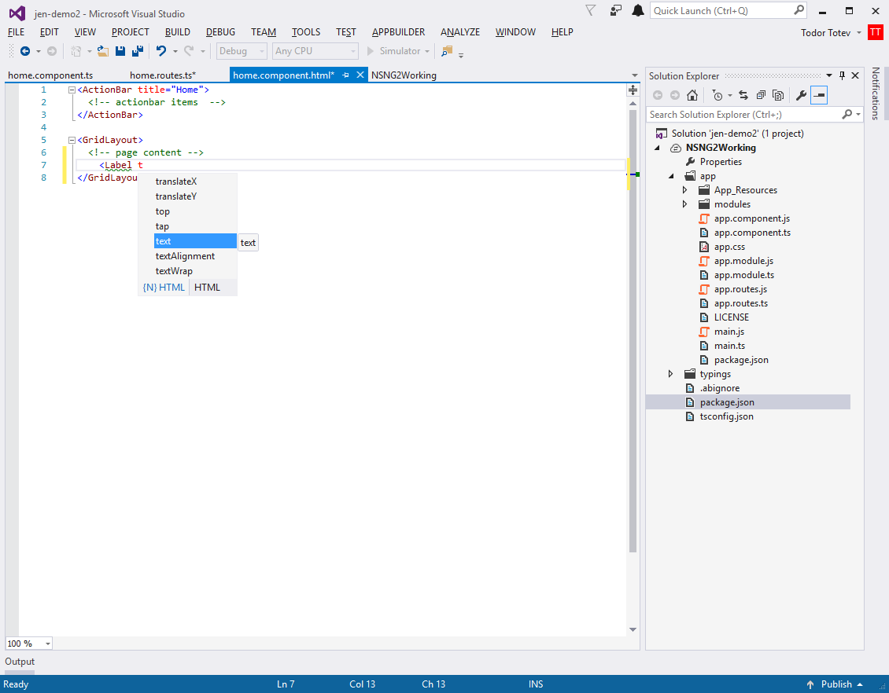
Telerik Platform 📱
Notes:
Jen Platform - Telerik platform - build apps using the online web tooling or use plugins for your favorite IDEs. The latest release for Platform has full support for NativeScript 2.3 and Angular 2! And the Visual Studio plugin has amazing enhancements that you should check out, including intellisense and full support for npm installations.

Slide 21
Plugins 🔌
Notes:
tj

Slide 22
Plugins 🔌
250+ plugins on npm!
Notes:
tj

Slide 23

OAuth🔑
https://github.com/alexziskind1/nativescript-oauth
Notes:
Tj Supported protocols: Microsoft Live, Office 365, Facebook, Google

Slide 24
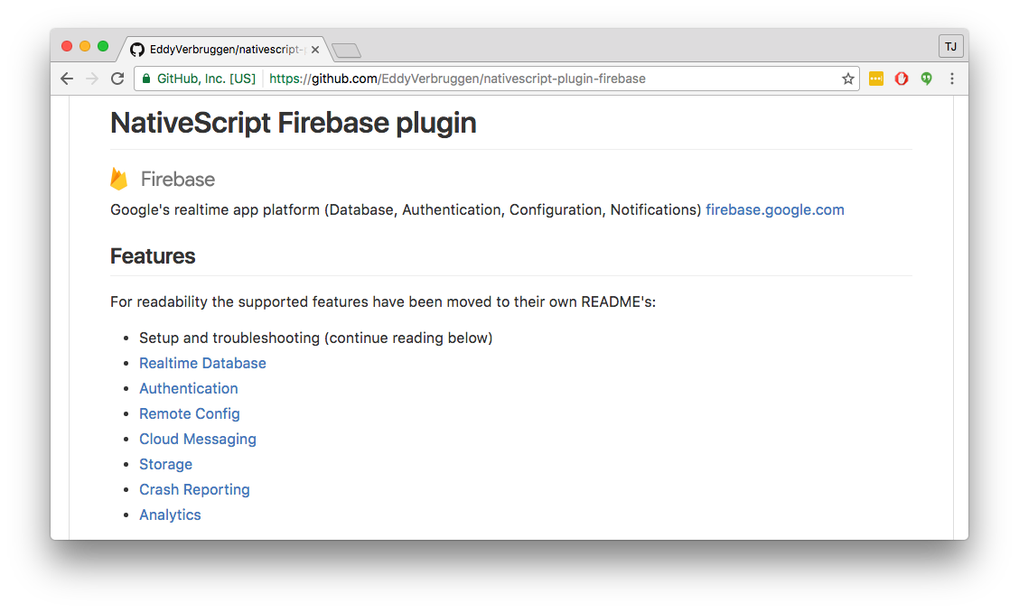
Firebase 🔥
Notes:
tj

Slide 25
Top Ten Plugins (by npm downloads) 🔌
10) 💸 nativescript-paypal (3,852)
Marcel Kloubert
9) 🌐 nativescript-grid-view (4,006)
Peter Staev
8) ⛅ nativescript-floatingactionbutton (4,916)
Brad Martin
7) 📬 nativescript-sqlite (5,108)
Nathanael Anderson
6) 🗺 nativescript-google-maps-sdk (5,266)
Dan Prietti
5) 🎹 nativescript-spotify (5,295)
Nathan Walker and Brad Martin
4) 📚 nativescript-slides (5,436)
Josh Sommer
3) 🔥 nativescript-plugin-firebase (6,523)
Eddy Verbruggen
2) 🏅 nativescript-apiclient (8,066)
Marcel Kloubert
1) 🏆 nativescript-toolbox (10,772)
Marcel Kloubert
Notes:
tj

Slide 26
Top Plugin Creators
11) 🐱 Peter Staev (5)
11) 🐭 Sean Perkins (5)
10) 🐶 Robert Laverty (6)
8) 🐷 Alex Ziskind (7)
8) 🐸 Steve McNiven-Scott (7)
7) 🐻 Josh Sommer (8)
6) 🐝 Nathan Walker (9)
5) 🐊 Osei Fortune (11)
4) 🐳 Eddy Verbruggen (14)
3) 🐬 Marcel Kloubert (15)
1) 🐢 Nathanael Anderson (22)
1) 🐍 Brad Martin (22)
Notes:
Tj Point out no Progress employees
I have 3

Slide 27
Community 💖
Notes:
Jen we love our community. Srsly one of the best

Slide 28
Community 💖
Engineering 💃
NativeScript Developer Experts 🎩
Slack channel standouts 🌮
Stack Overflow contributors 🎂
Contest winners! 💰
Notes:
Jen Give numbers of Slack participation (1958)

Slide 29
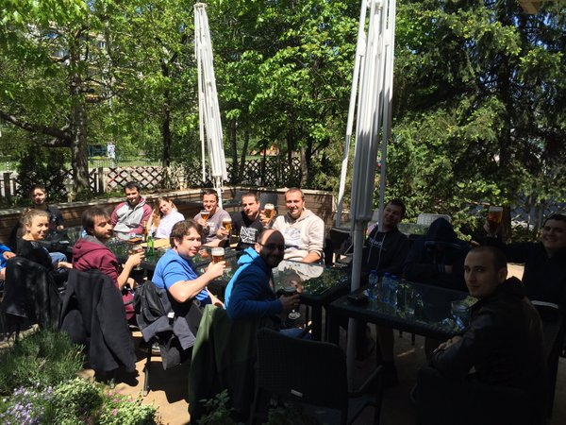
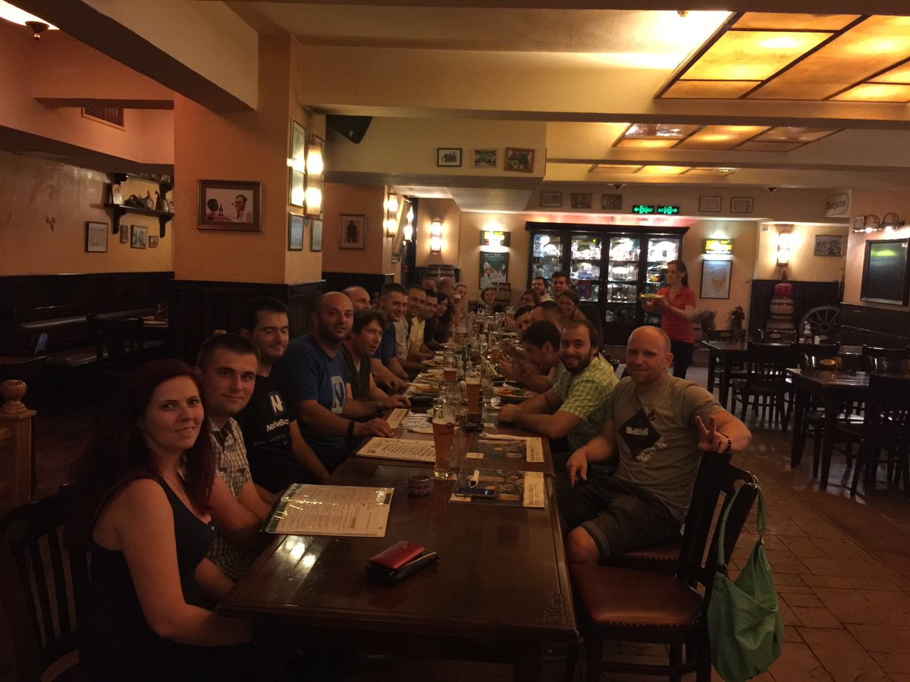
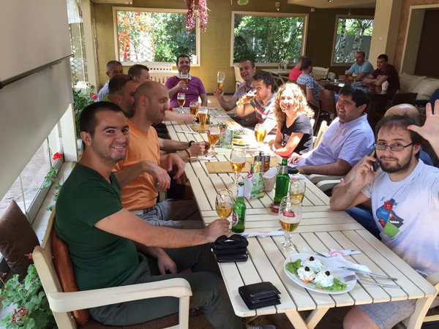
Community starts with Engineering 💃
Notes:
Jen

Slide 30

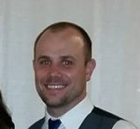


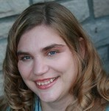











NativeScript Developer Experts 🎩
Notes:
(Jen) George Saadeh, Brad Martin, Steve McNiven-Scott, Mike Branstein, Carey Payette
Houssem Yahiaoui, Osei Fortune, Nic Raboy, Josh Sommer, Alex Ziskind, Nathan Walker
Nick Branstein, Lino Tadros, Nathanael Anderson, George Edwards, Ray Camden
There are 38 Telerik Developer Experts in 13 different countries, specializing in the Telerik Platform, Kendo UI, Sitefinity and more.

Slide 31
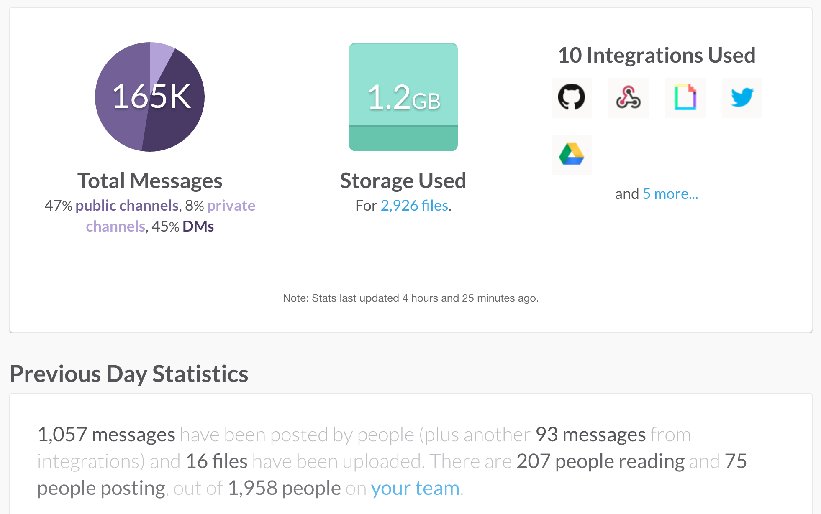
Slack channel stats 🌮
Join us! http://tinyurl.com/nativeScriptSlack
Notes:
Jen

Slide 32
Slack channel standouts 🌮
1,900+ members! With Top Contributors:
10) 🍏 don (15)
9) 🍐 peterstaev (15)
8) 🍪 sitefinitysteve (21)
7) 🍞 markosko (27)
6) 🍓 jen.looper (28)
5) 🍉 sean (38)
4) 🍭 walkerrunpdx (53)
3) 🍊 nathanaela (57)
2) 🍳 bradmartin (66)
1) 🍕triniwiz (119)
Join us! http://tinyurl.com/nativeScriptSlack
Notes:
Jen

Slide 33
Stack Overflow contributors 🎂
10) 🚗 G. McGhie (15)
9) 🚌 George Edwards (15)
8) 🚑 Osei Fortune (22)
7) 🚓 Peter Staev (32)
6) 🚚 Nikolay Tsonev (42)
5) 🚒 Todd Anglin (52)
4) 🚲 Brad Martin (61)
3) 🚂 Emil Oberg (62)
2) ⛵ Nick Iliev (83)
1) 🚀 Nathanael Anderson (115)
Join us! http://stackoverflow.com/tags/nativescript/
Notes:
Jen

Slide 34
Contest winners 💰
Notes:
(Jen)

Slide 35
Apps 📱
Notes:
(TJ)

Slide 36

Thanks! 😊💃⛵

